Slide 2
NAVIGATE
OUR
DIGITAL
WORLD

Slide 3
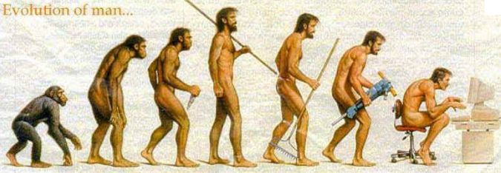

Slide 4
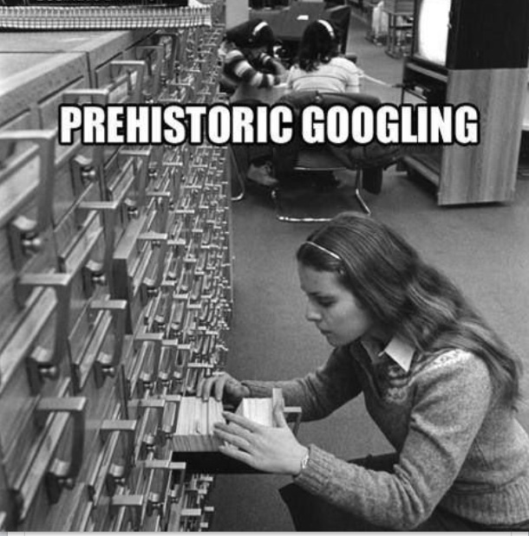

Slide 5
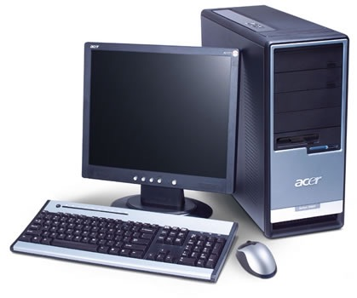
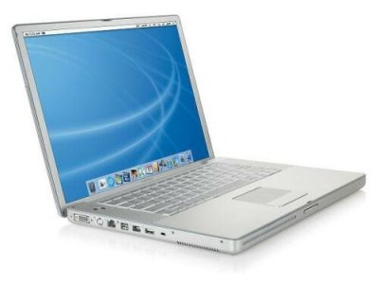
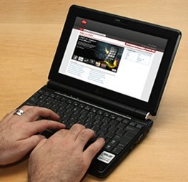

Slide 6
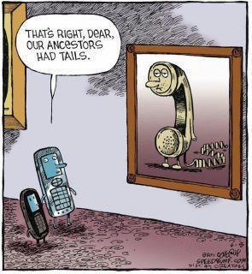

Slide 7
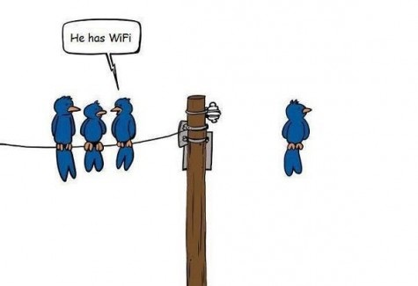

Slide 8
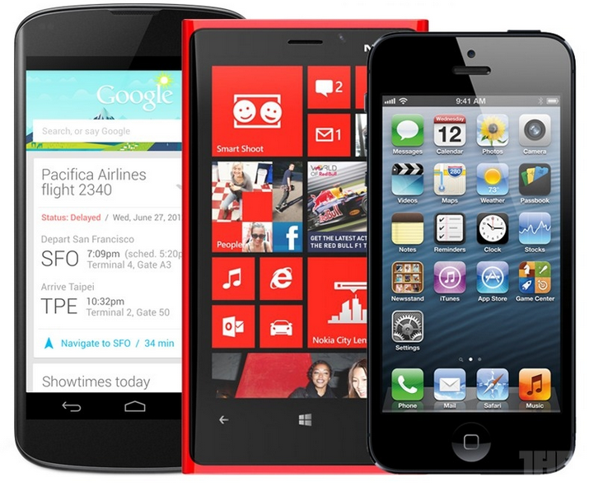

Slide 9
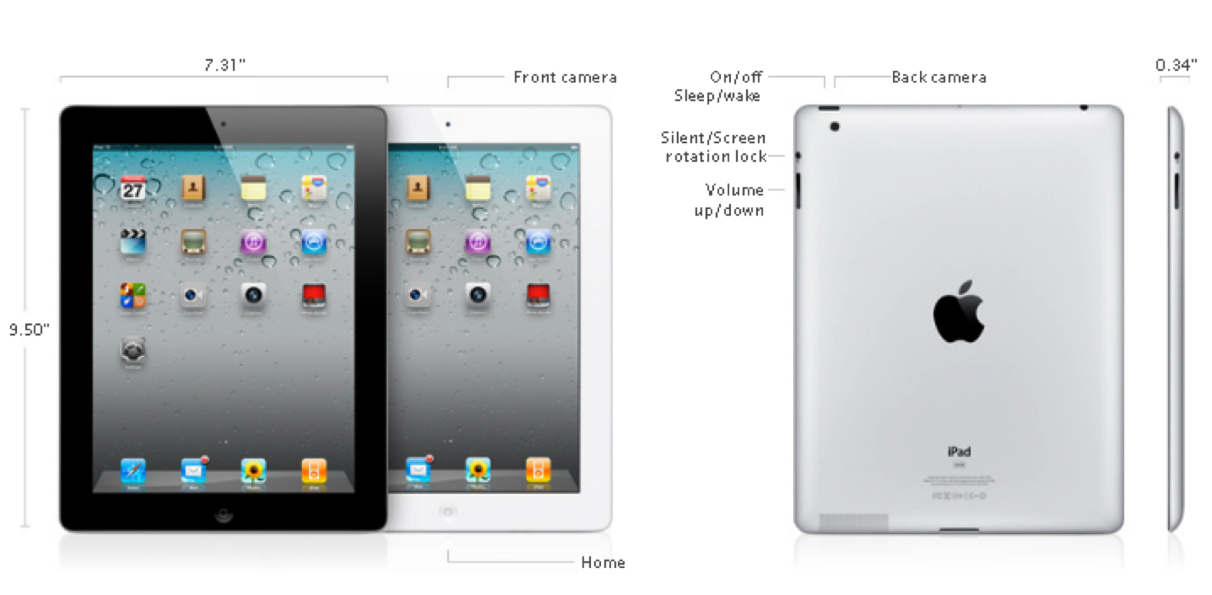

Slide 10
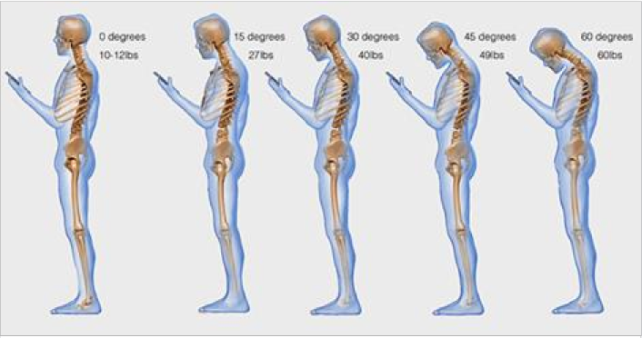
60 degrees = 60 lbs

Slide 11
WiFi vs 4G/5G/…
(cellular data)

Slide 12
3 Things to Consider
Cost
Look
Feel

Slide 13
What the F is Facebook?

Slide 14
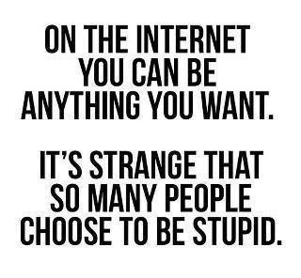

Slide 15
The “FRONT DOOR” Test

Slide 16
GO RETRO

Slide 17
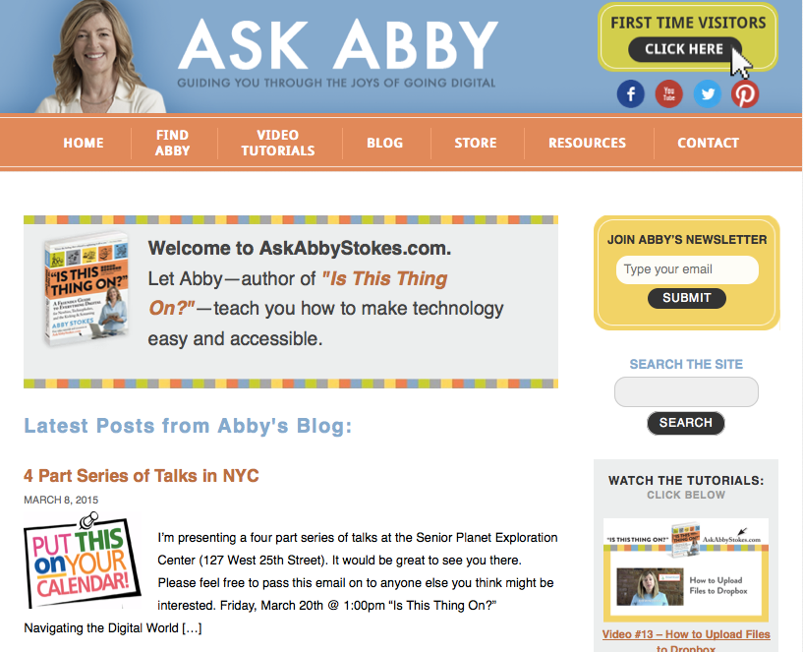
AskAbbyStokes.com

Slide 18
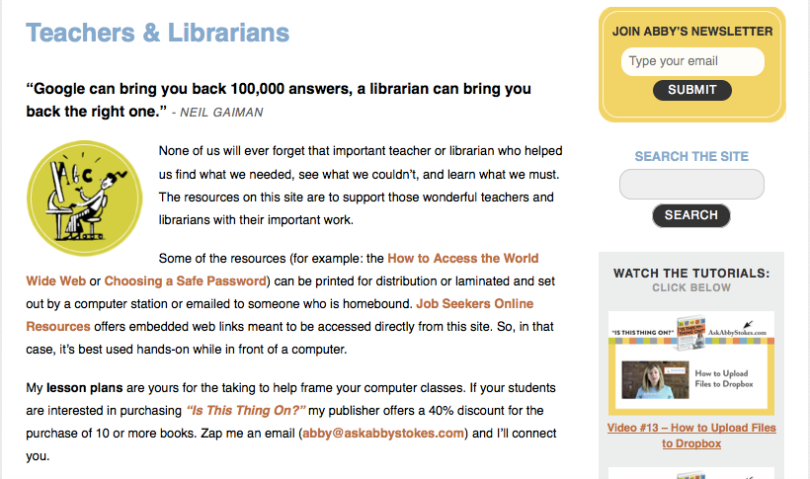
AskAbbyStokes.com

Slide 19
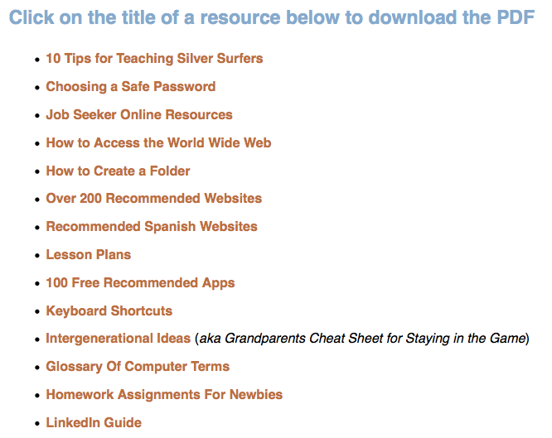
AskAbbyStokes.com

Slide 20
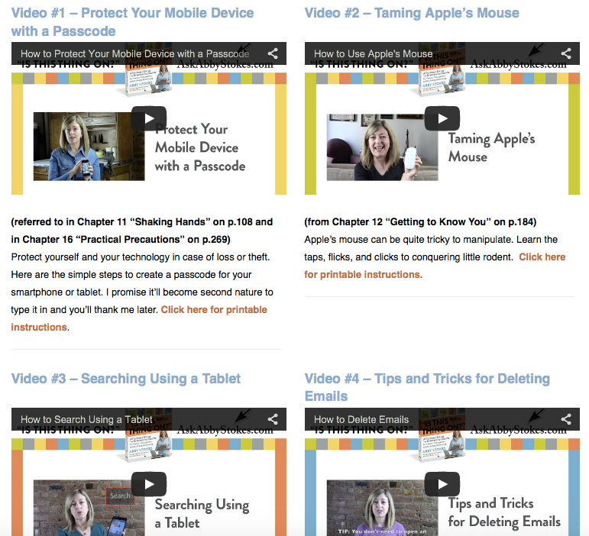
AskAbbyStokes.com

Slide 21
AskAbbyStokes.com

Slide 22
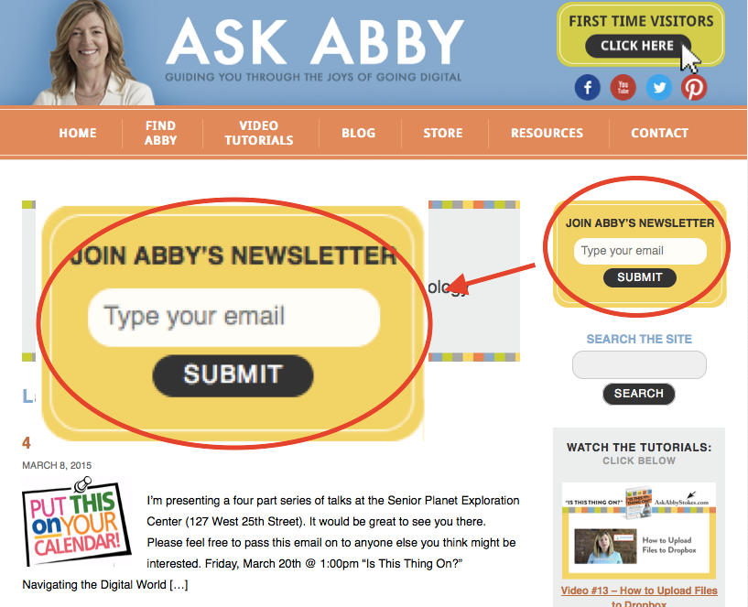
AskAbbyStokes.com

Slide 23
AskAbbyStokes.com
facebook.com/AskAbbyStokes
abby@AskAbbyStokes.com

